Slide 1


Slide 2
PCB DESIGN FOR CYCLIC VOLTAMMETRY BOARD
Name: Dhruv Dhanraj Sawarkar
College Reg No.: 23070634
Application no.: 2879
Institution: Yeshwantrao Chavan College of Engineering Nagpur.
Department: Electrical Engineering and Computer Science
Lab: Sixth sense lab
Supervisor: Dr. Santanu Talukder
Duration: 26 may, 2025 – 21 June, 2025

Slide 3
INTRODUCTION:
This project focuses on the design and development of a Cyclic Voltammetry (CV) board, which is used for electrochemical analysis to study redox reactions.
The work involved understanding the working principles of 2-electrode and 3-electrode systems, designing current detection circuits using operational amplifiers, and simulating them in LTspice. The final circuit was translated into a PCB layout using KiCad.

Slide 4
PCB DESIGN OF RC PHASE SHIFT OSCILLATOR.
We were asked to design a PCB for an RC Phase Shift Oscillator which was carried out at Ki-cad. It was a single-layer PCB.
Key Components Used:
Operational Amplifier (op-amp)
Resistors
Capacitors (typically 0.01 µF)
Power supply as per requirement

Slide 5
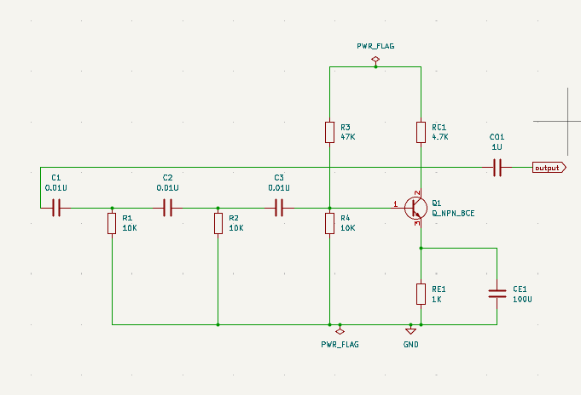
PCB SCHEMATIC OF RC PHASE SHIFT OSCILLATOR.
Figure 1

Slide 6
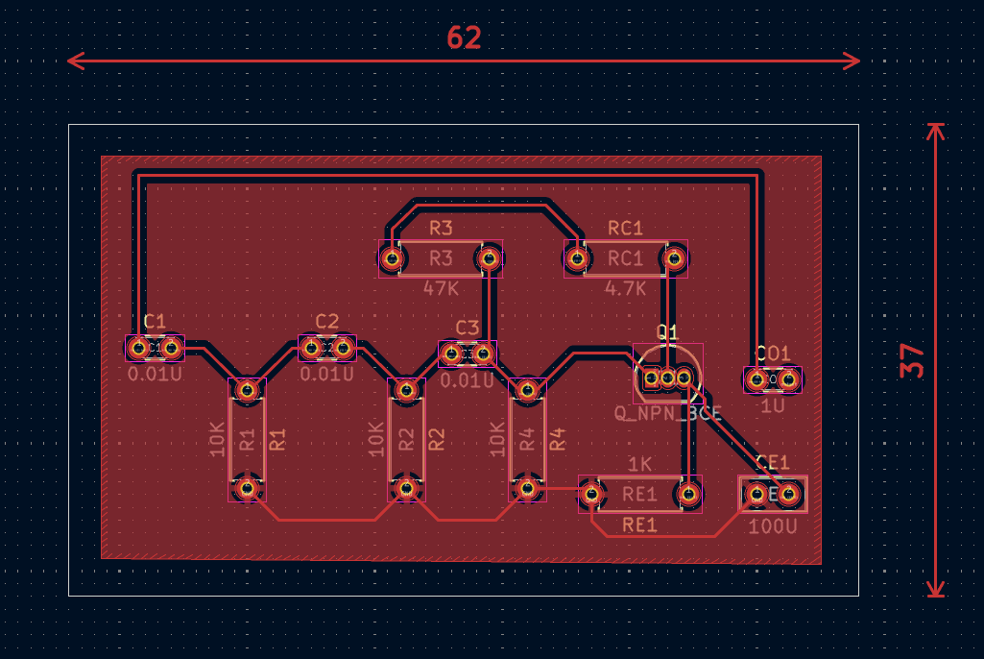
PCB LAYOUT OF RC PHASE SHIFT OSCILLATOR.
Figure 2

Slide 7
CURRENT DETECTION CIRCUIT.
Our team worked on designing a current sensing circuit using a transimpedance amplifier (TIA) setup. LTspice was used for simulating performance, and the circuit was later implemented in KiCad.
- Designed a current sensing circuit using a Transimpedance Amplifier (TIA)
- Used LTSpice for simulation and KiCad for PCB design.
- Target current range: (1 µA to 200 µA).
- LM158 used with high-value feedback resistor e.g.100kΩ
When current in downward Direction, Output voltage = (Input current × Feedback resistor)
- Example: If input current = 1 µA and feedback resistor = 100 kΩ,
then output voltage = (1 µA × 100 kΩ) = 100mV

Slide 8
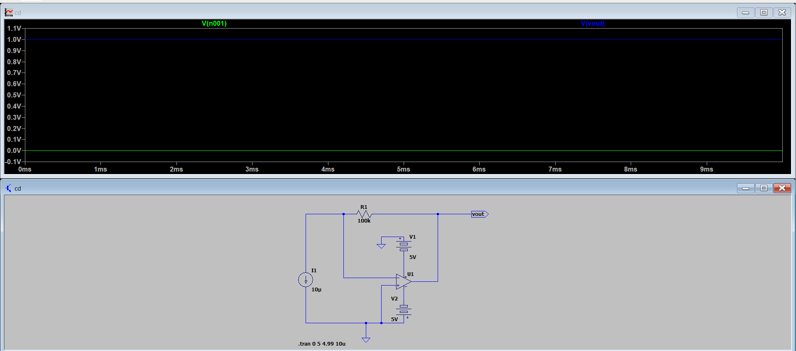
LTSPICE SIMULATION OF CURRENT DETECTION CIRCUIT.
Figure 3

Slide 9
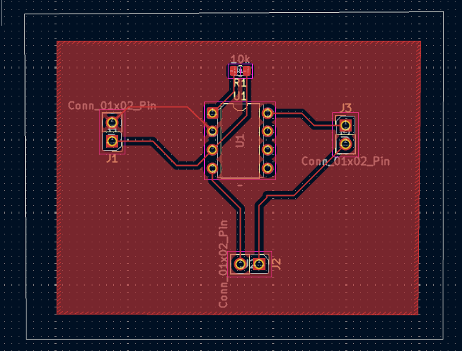
PCB LAYOUT OF CURRENT DETECTION CIRCUIT.
Figure 4

Slide 10
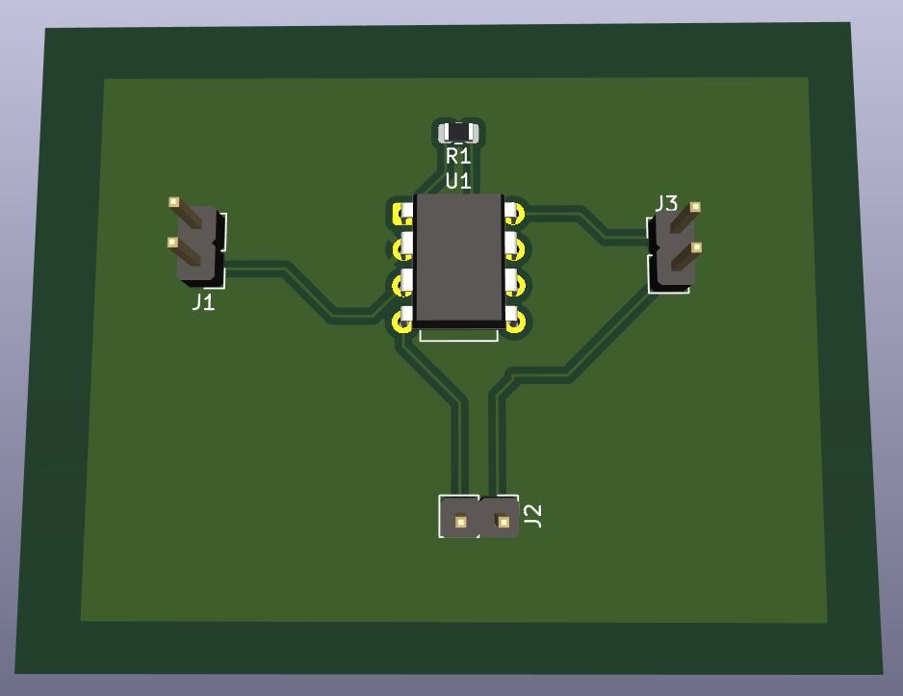
3D VIEW OF CURRENT DETECTION CIRCUIT.
Figure 5

Slide 11
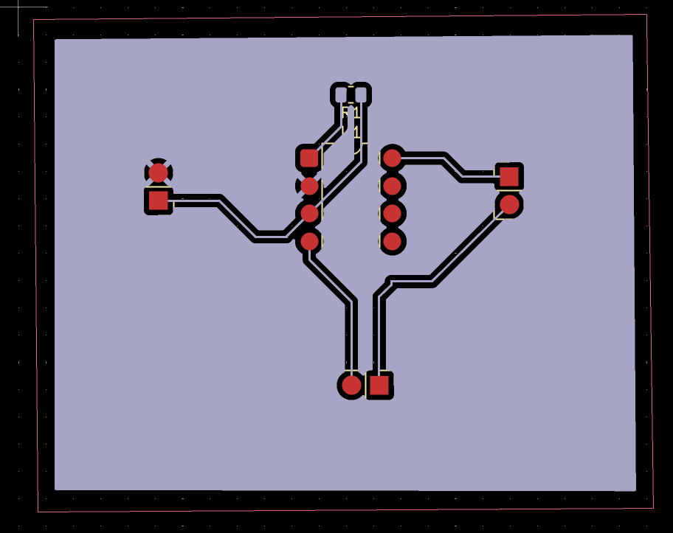
GERBER VIEW OF CURRENT DETECTION CIRCUIT.
Figure 6

Slide 12
MY LEARNINGS.
Learned complete workflow of KiCad: schematic design, PCB layout, and 3D view
Got familiar with LTSpice for analog circuit simulation and waveform analysis
Understood the concept of 2-electrode and 3-electrode systems used in electrochemical analysis
Designed circuits like the RC Phase Shift Oscillator and Current Detection (TIA).
Developed a low-current sensing circuit (1 µA to 200 µA) using a Transimpedance Amplifier

Slide 13
Thank you.

